Slide 1
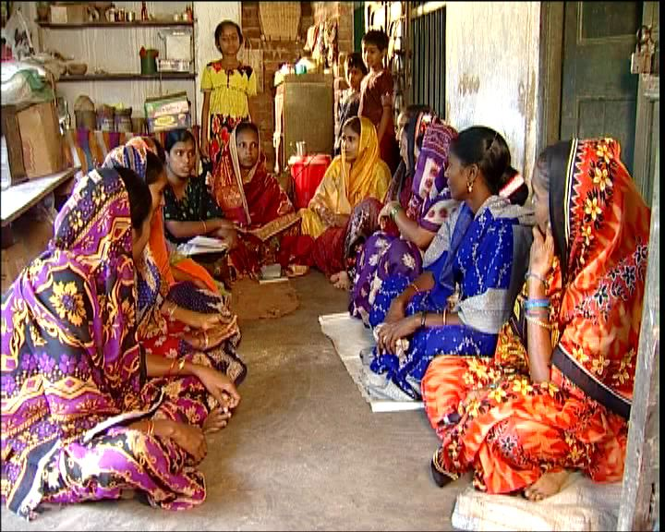
A Study on Self-Help Groups in India
A summary by Grecia Reyes and Bethel Hamel

Slide 2
Introduction: SHG’s
Supported and dformed by Ngo’s, government agencies, or banks
Benefits:
  Enable women to grow their savings, and have access to credit
  Enable women to become active agents in their community socially and politically (i.e Political election & rights)
  The study: conducted Andhra Pradesh Karnataka, the southern region, Orissa, and Rajasthan in the north.

Slide 3
The Findings: Outreach
SHG members
  The groups are created to extent financial services to the poor and contribute to the alleviation of rural poverty
  The poverty profile:
  Highlights
    Targets are those below poverty line or at risk
      Members have low levels of education, work as casual labourers
    The leaders are all of caste
  The problem
    More than half of long term members are still poor, and 13% very poor
    At group level, they are not homogeneous by wealth (which affects ‘equity’ (p.10)
    Nearly half of members are related to each other

Slide 4
Outreach cont.
Who does not join?
  Migrant workers—excluded due to the regulations of SHG groups. (I.e. attending regular meetings, savings, loan repayments )
  Requirements present barriers that exclude certain groups and target others
Dropouts
  How many? Who? Why?
    Two regions combined--10% dropout rate of membership. Almost 50% of the SHGs had no dropouts; one-third had two or fewer dropouts.
    Migration for employment outside the village, and financial difficulties, group dynamics
  The problem:
    Dropouts are entitled to receive back their loans + interest, but most are not receiving it

Slide 5
The social Roles of SHG’s
Political opportunities for women
  SHG membership can develop leadership abilities
    effective community leaders
  Women become more “visible” in the village
  Potential candidates for political office
Social harmony
  The caste system
  Most SHG’s groups are single-caste groups, based on the requirement of being small groups and within neighborhood proximity
  Ngo’s —have taken initiative in creating mixed caste membership
  It takes time and persistence to convince members, but it’s helping break down prejudice

Slide 6
Social Justice
SHG’s are not dealing regularly with issues affecting women
  Domestic violence, bigamy, cases of dowry deaths, prevention of child marriage, remarriage for widows
Guidance and support are necessary, especially when such issues have become the norm.
Private behavioral problems are more difficult to address and follow up
Case studies illustrate the combination of personal determination (especially from the women concerned), mutual support (SHG members) and effective guidance (SHPA field worker) can make the difference against conservative, male-supporting, social structures (pg.14)
SHPA—NGO’ and government seem to be more effective In awareness campaigns or dealing with police authorities

Slide 7
Sustainability
Record Keeping:
  Findings: 15% SHG’s have good quality records; 39% were mostly up to date with minor errors
The problem with record keeping
  The complexity of record keeping
    The amount of records and work to record transactions
    Leader of the group has low level of education, finding this difficult to manage or understanding the importance of it

Slide 8
Sustainability
Equity
  Is the access to available credit equitable?
  This is not referring to the amount given to members as being equally distributed; each has different demands and financial capacity of repayments.
The group leaders
In some SHGs (up to 18%), leaders are accessing more credit, especially over a longer time frame. This is known by other group members and is not necessarily seen to be exploitative (Pg.17).

Slide 9
Defaults & Recoveries
Loan repayment: Two stages of recovery
  1. Members to SHG 2. SHG to banks
  What type of members fail to repay? What happens to them?
  For loan repayments, the stated norm is monthly payment of interest and part of the chief amount of the loan
The findings: Statistics (p.17)
  The North -24% borrowers more than three months behind, of whom 5% were 12 months behind
  The south-28% of borrowers were 12 months overdue
  The leaders—also default on loans (slightly higher in the South)
Members make repayments on behalf, extreme pressure is used through warnings, fines, and more aggressive terms (taking possessions away ect)

Slide 10
Implications
SHG’s must focus on the need to transparent management and guidance to make it sustainable and effective
  Clear guidelines & organized record keeping
  Good keeping is essential for the financial operations and trust among members of the group
Empowering the rights of women
  SHPAs need to pick up problems, addressing them as they arise, using them as issues/examples for discussion with other groups. This kind of support is critical
Credit on Loans
  As amounts of external loans start increasing, some members may take higher loans than the rest, based on their absorption capacity (pg. 24)

